Slide 1
Discrete Fourier Transform
Ajit Rajwade
CS 663

Slide 2
Fourier Transform
You have so far studied the Fourier transform of a 1D or 2D continuous (analog) function.
The functions we deal with in practical signal or image processing are however discrete.
We need an equivalent of the Fourier transform of such discrete signals.

Slide 3
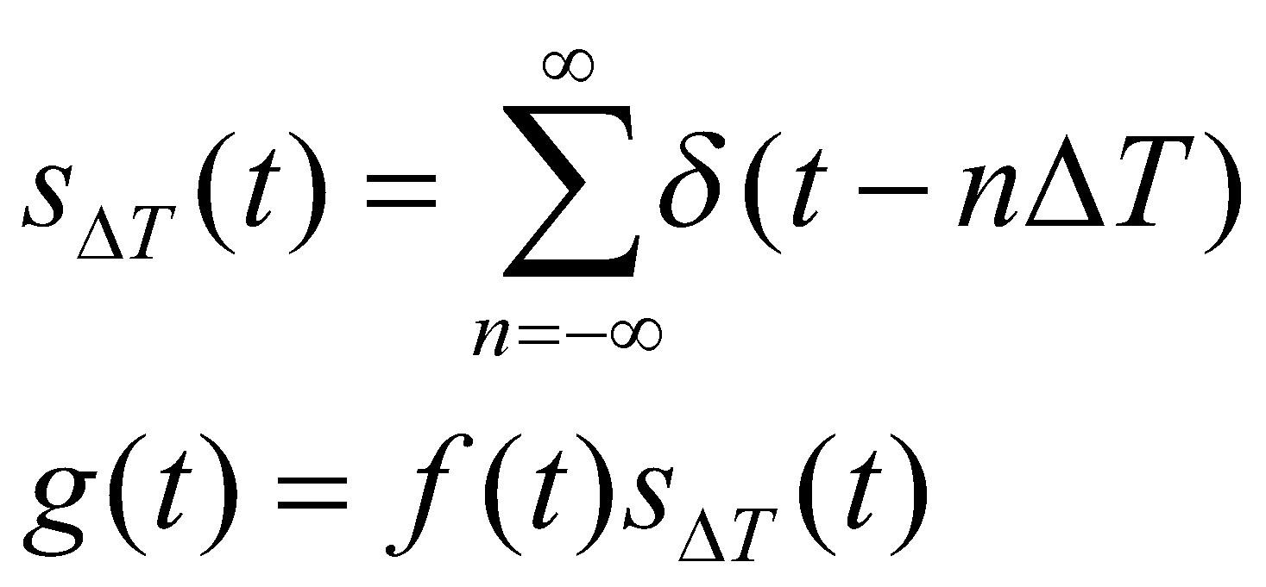
Towards the Discrete Fourier Transform
Given a continuous signal f(t), we will consider signal g(t), obtained by sampling f(t) at equally-spaced time instants.
So g(t) is the pointwise product of f(t) with an impulse train s_{ΔT}(t) given by:
The impulse functions here are Dirac delta functions.

Slide 4
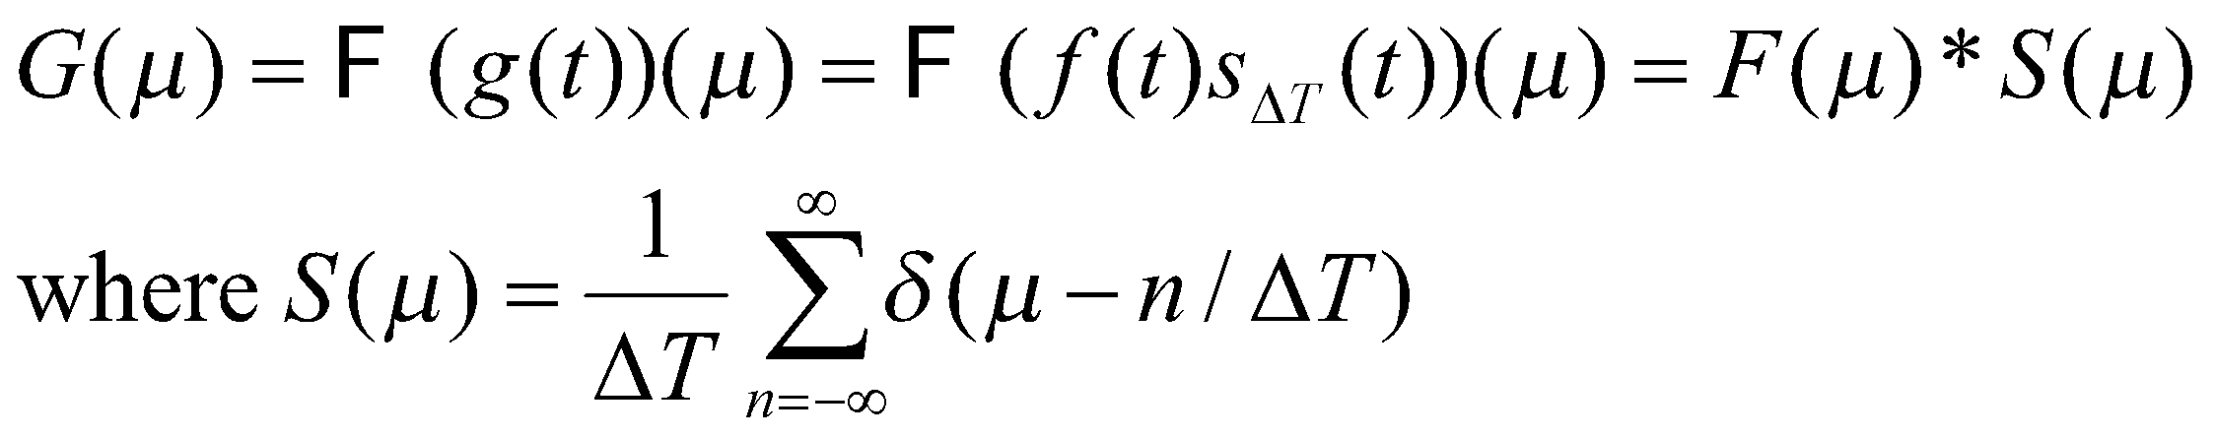
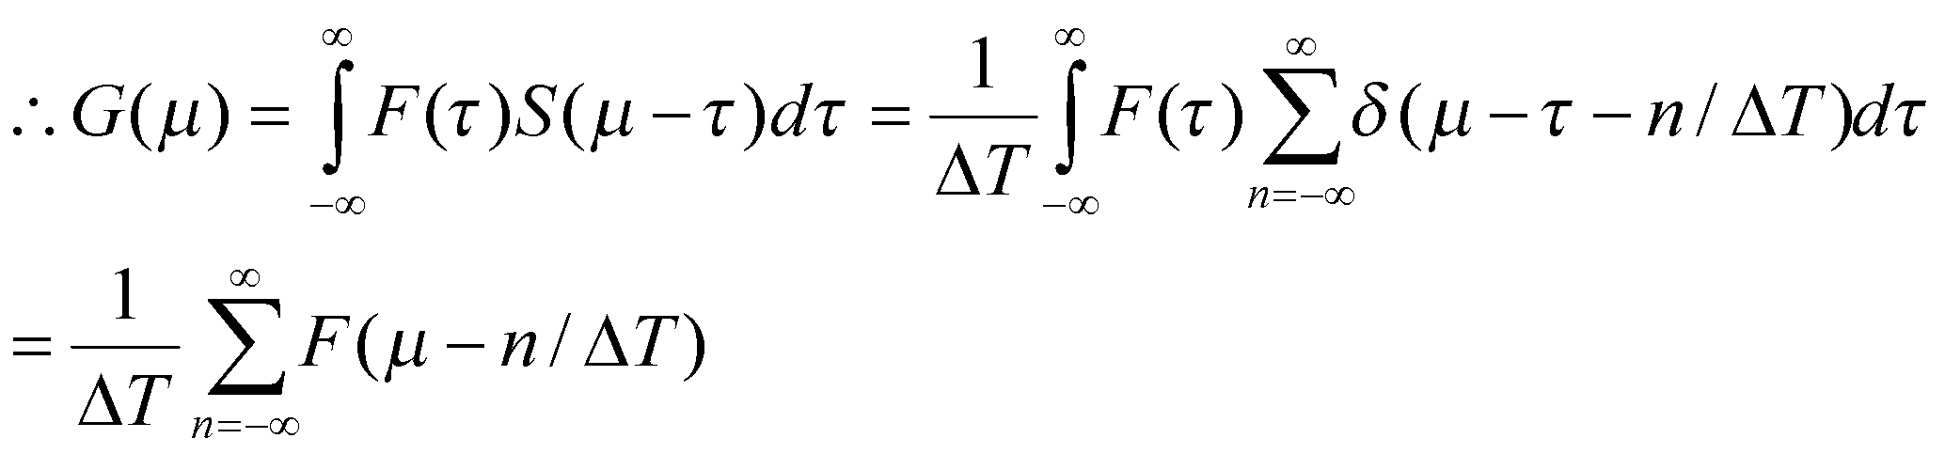
Towards the Discrete Fourier Transform
Check the book for the derivation for this (see Appendix at the end of the slides)
This shows that the Fourier transform G(μ) of the sampled signal g(t) is an infinite periodic sequence of copies of F(μ) which is the Fourier transform of f(t). The periodicity of G(μ) is given by the sampling period ΔT. Also though g(t) is a sampled function, its Fourier transform is continuous.

Slide 5
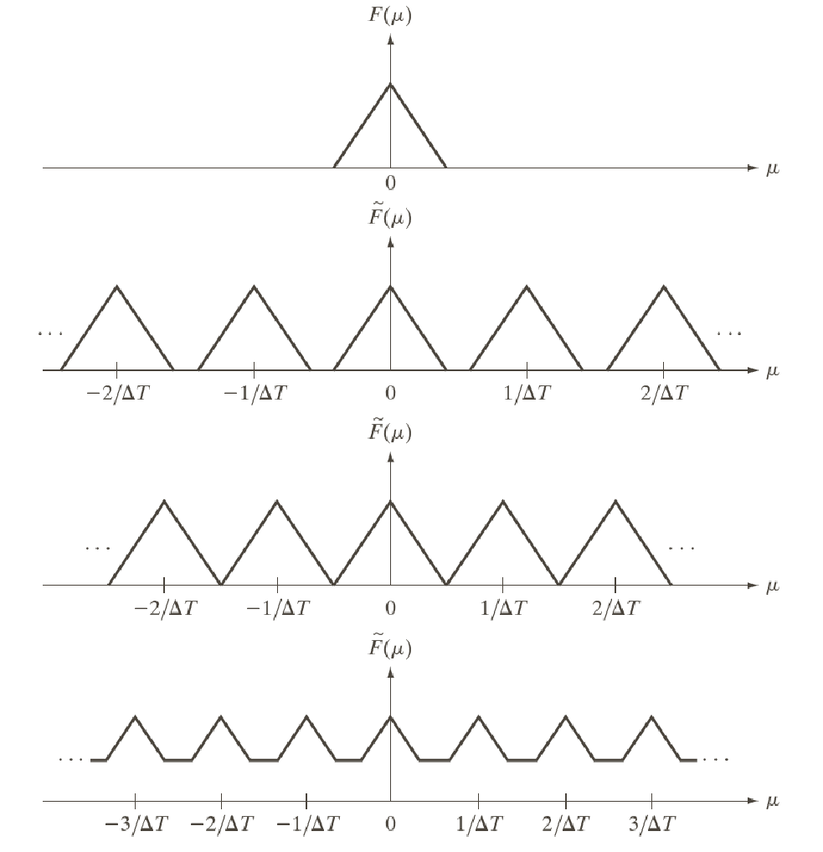
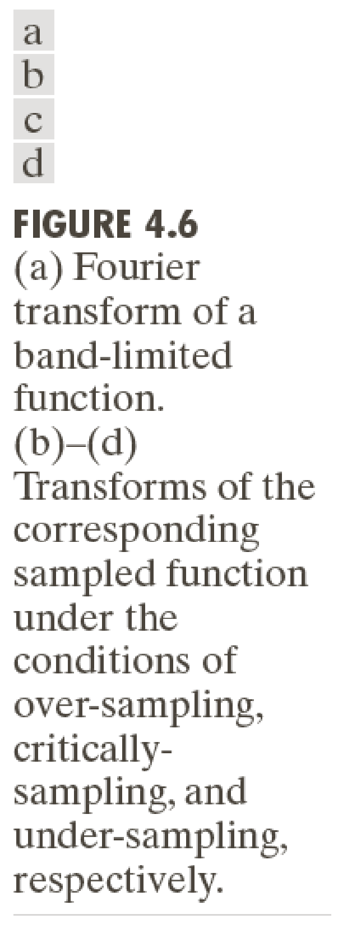
G(μ)
G(μ)
G(μ)

Slide 6
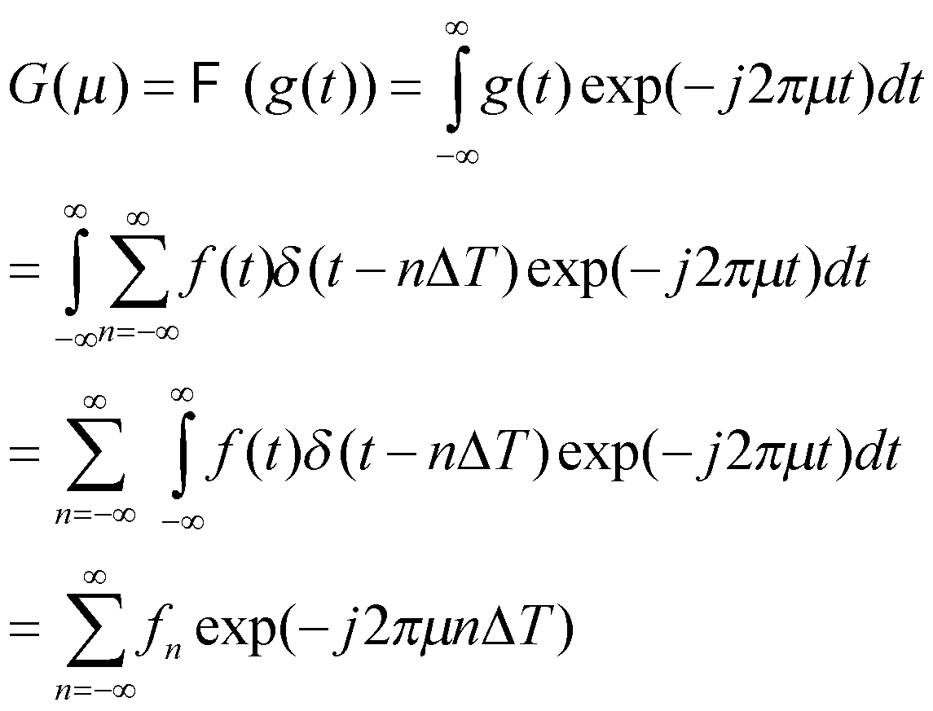
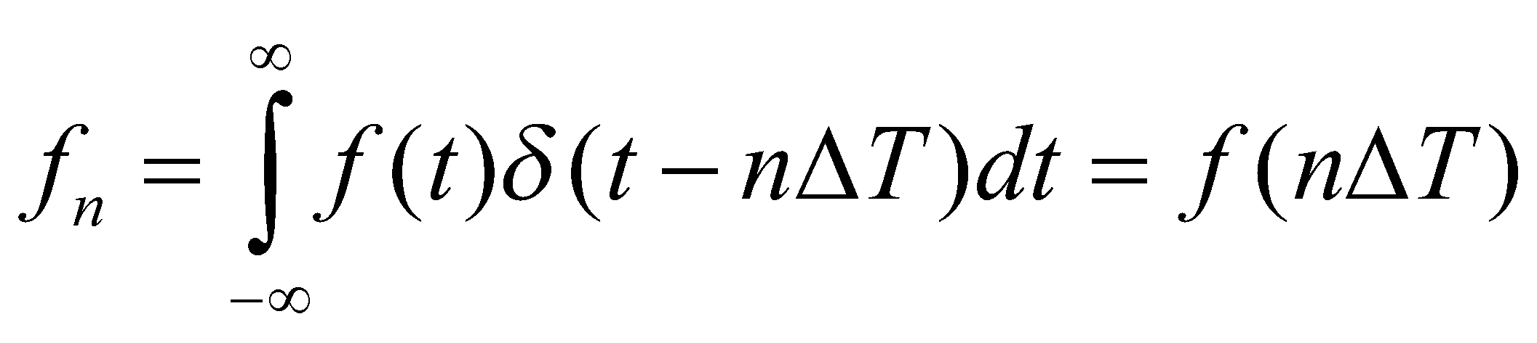
Towards the Discrete Fourier Transform
Let us now try to derive G(μ) directly in terms of g(t) instead of F(μ).
f(t)δ(t-nΔT) is the sampled function (a Dirac impulse weighted by f(t)). To get the actual sample values (the strength of the impulse), we do an integration, i.e. of the following form:

Slide 7
Towards the Discrete Fourier Transform
We have seen earlier that the Fourier transform of g(t) is periodic with period 1/ΔT, so it is of interest to characterize one period.
Consider that we take some M equally spaced samples of G(μ) over one period from μ = 0 to 1/ΔT.
This gives us frequencies of the form μ = u/MΔT where u = 0,1,2…,M-1.

Slide 8
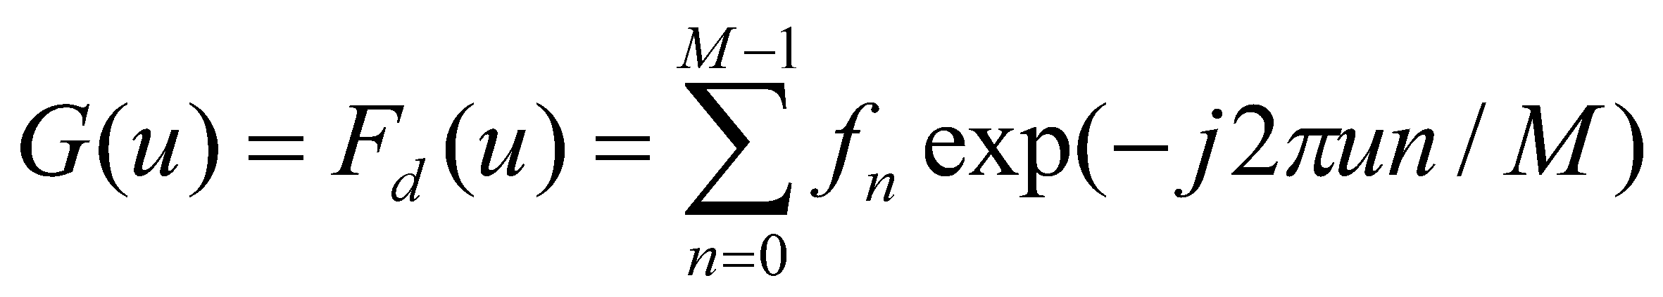
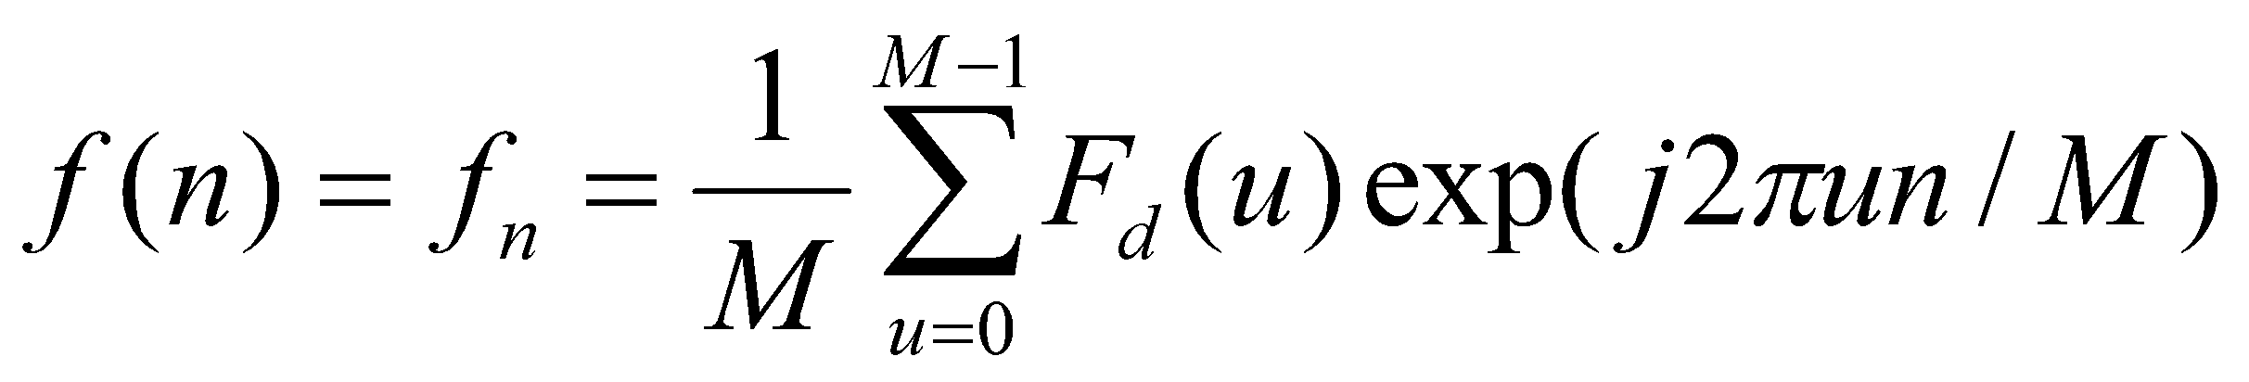
Towards the Discrete Fourier Transform
Plugging these values for μ we now have:
This is called the Discrete Fourier Transform of the sequence {f_{n}} where n = 0,1,…,M-1.
Given the sequence {F_{d}(u)} where u = 0,1,…M-1, we can recover {f_{n}} using:
This is the inverse Discrete Fourier Transform (IDFT).

Slide 9
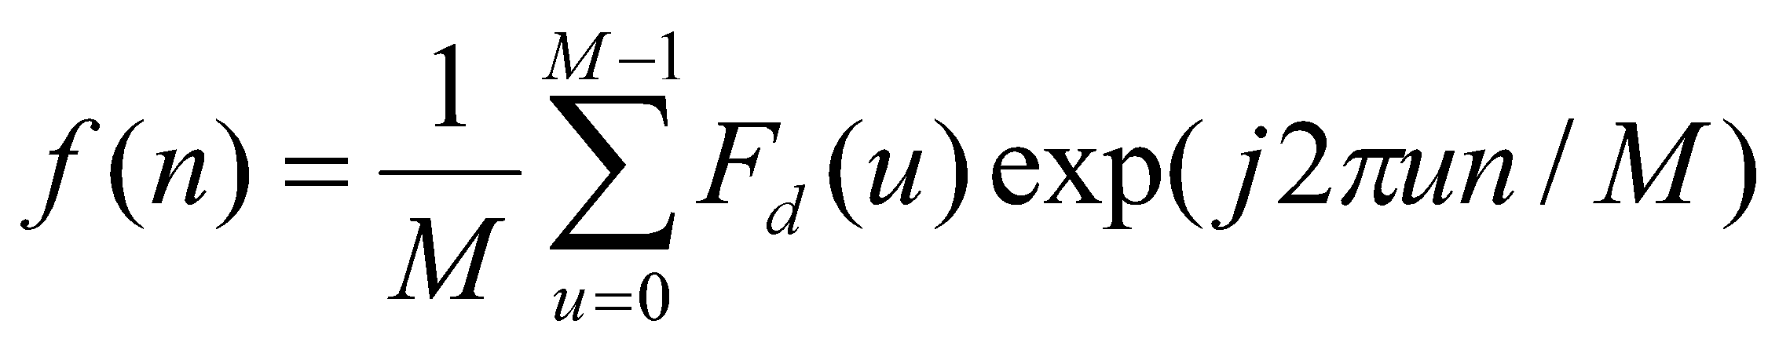
Towards the Discrete Fourier Transform
Consider:
It can be proved that plugging in the expression for f(n) into the expression for F_{d} (u) yields the identity F_{d} (u) = F_{d} (u).
Also plugging in the expression for F_{d} (u) into the expression for f(n) yields the identity f(n) = f(n).

Slide 10
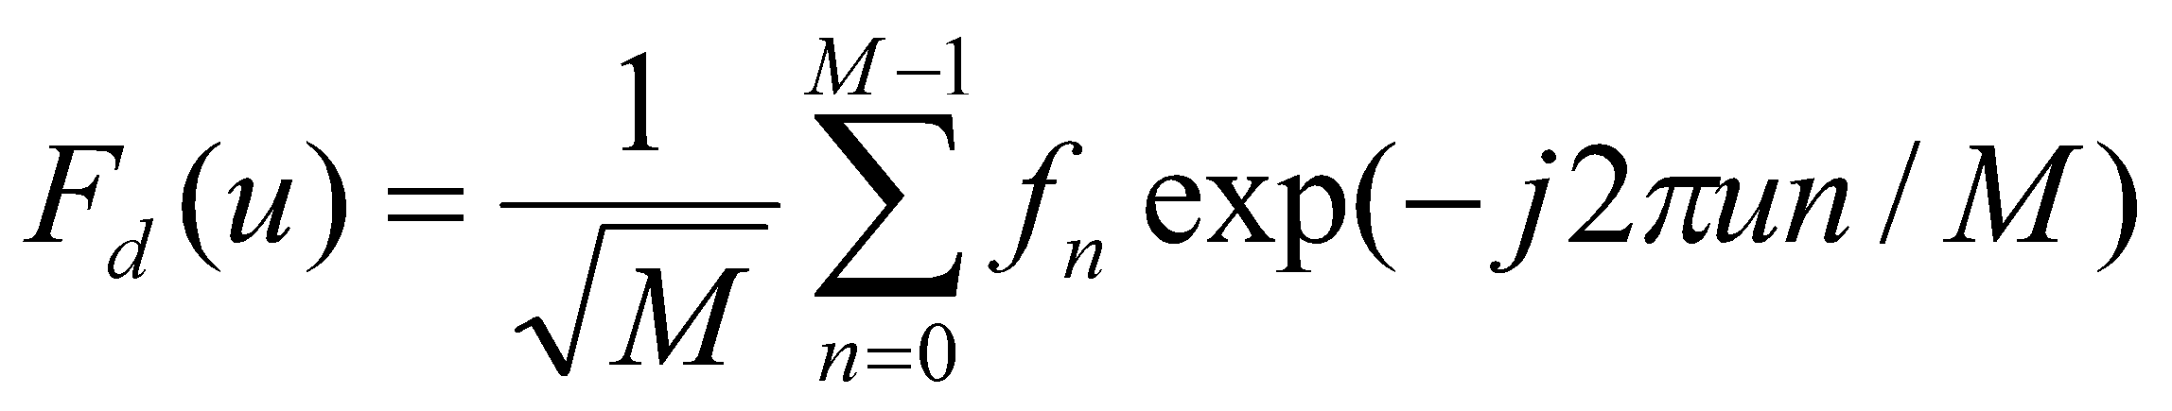
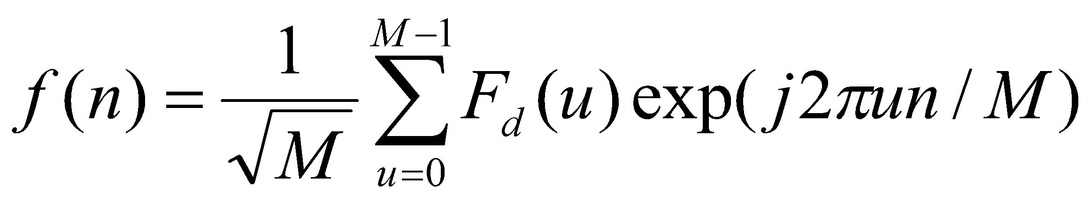
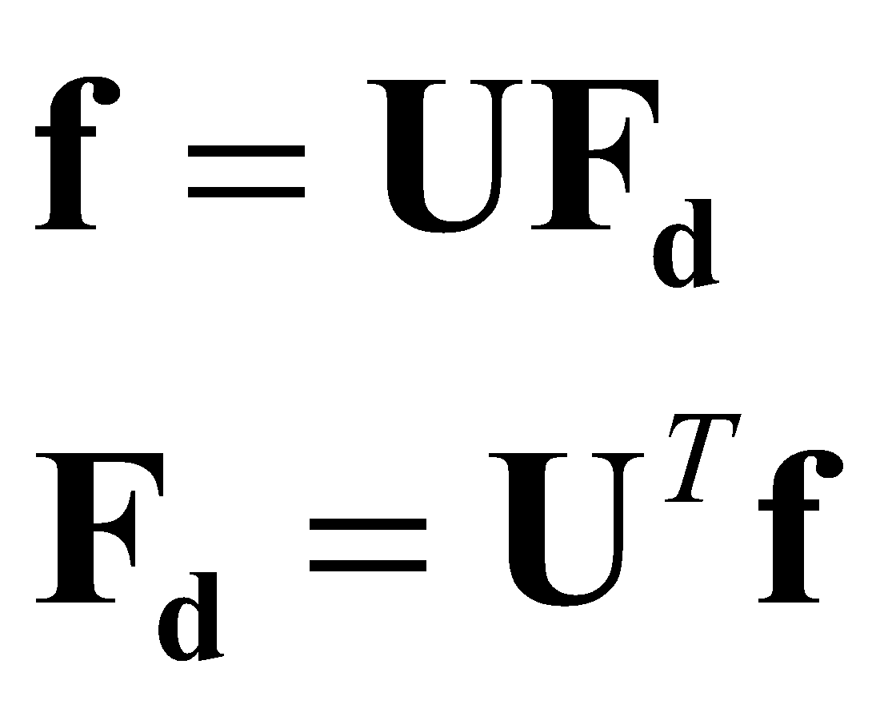
Towards the Discrete Fourier Transform
In some books, the following expressions are used:
Note that the above expressions can be written in the following matrix vector format:
MATLAB does NOT follow this convention – it follows the one on the earlier slide.
Vectors of size M by 1
U turns out to be an orthonormal M by M matrix – called the discrete Fourier basis matrix or DFT matrix. The square root of M in the denominator is required for U to be orthonormal, else it would be proportional to an orthonormal matrix.

Slide 11
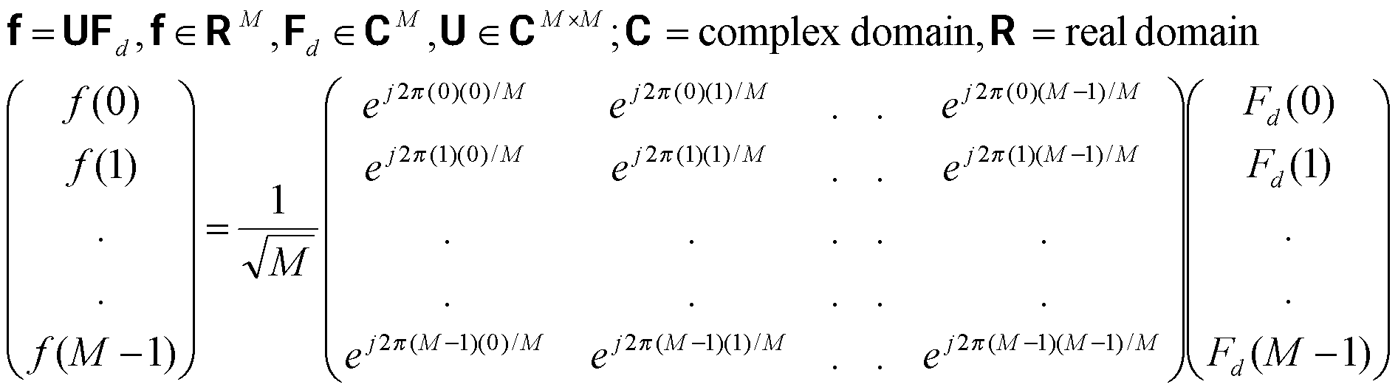
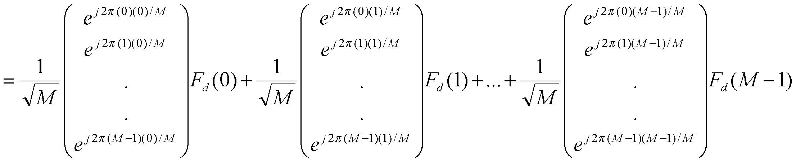
Vectors of size M by 1
U is an orthonormal M by M matrix – called the discrete Fourier basis matrix or DFT matrix. The square root of M is required for U to be orthonormal, else it would be proportional to an orthonormal matrix.
Notice in the last equality how the signal f is being represented as a linear combination of column vectors of the DFT matrix. The coefficients of the linear combination are the discrete Fourier coefficients!

Slide 12
Sampling in time and frequency
Remember that the function g(t) was created by sampling f(t) with a period of ΔT.
And the spacing between the samples in the frequency domain (to get the DFT from G(μ)) is
1/ MΔT since μ = u/MΔT where u = 0,1,2…,M-1.
Likewise the range of frequencies spanned by the DFT is also inversely proportional to ΔT.

Slide 13
DFT properties
Linearity: F(af+bg)(u) = aF(f)(u) + bF(g)(u)
Periodicity: F(u) = F(u + kM) for integer k,
And so is the inverse DFT since f(n) = f(n+kM).
The DFT is in general complex. Hence it has a magnitude |F(u)| and a phase.

Slide 14
Clarification about DFT
We have seen earlier that the Fourier transform G(μ) of the sampled version g(t) of analog signal f(t) is continuous.
We also saw earlier that we take some M equally spaced samples of G(μ) over one period from μ = 0 to 1/ΔT.
This way the DFT and the discrete signal both were vectors of M elements.
Obtaining the DFT given the signal (or the signal given its DFT) is an efficient operation owing to the orthonormality of the discrete fourier matrix (why efficient? Because for an orthonormal matrix, inverse = transpose).
Why don’t we take more than M samples in the frequency domain?
If we did, the aforementioned computational efficiency would be lost. The inverse transform would require a matrix pseudo-inverse which is costly.
Also the columns of the orthonormal matrix U^{T}(size M x M) constitute a basis: i.e. any vector in M-dimensional space can be uniquely represented using linear combination of the columns of that matrix. If you took more than M samples in the frequency domain, that uniqueness would be lost as U^{T} would now have size M’ x M where M’ > M.

Slide 15
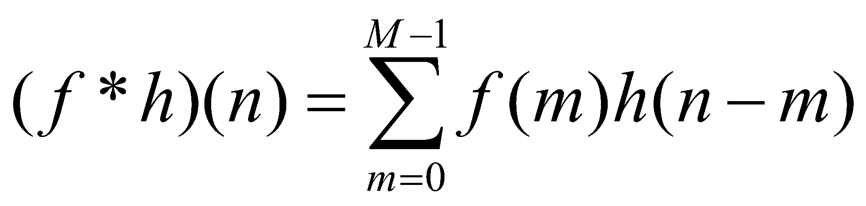
Convolution of discrete signals
Discrete equivalent of the convolution is:
Due to the periodic nature of the DFT and IDFT, the convolution will also be periodic.
The above formula represents one period of that periodic resultant signal.

Slide 16
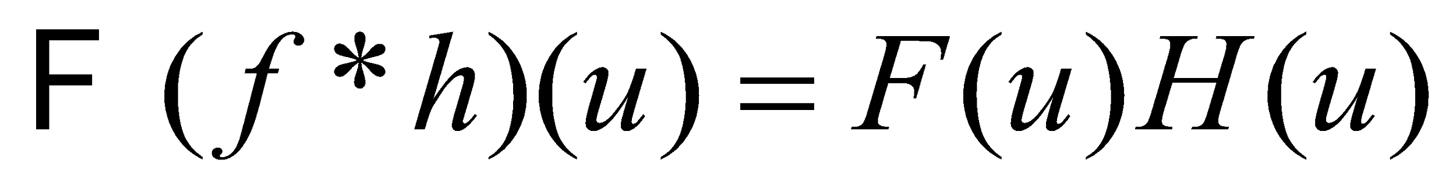
Convolution of discrete signals
The convolution theorem from continuous signals has an extension to the discrete case as well:
Therefore discrete convolution can be implemented using product of DFTs followed by an IDFT.
But in doing so, one has to account for periodicity issues to avoid wrap-around artifacts (see next slide).

Slide 17
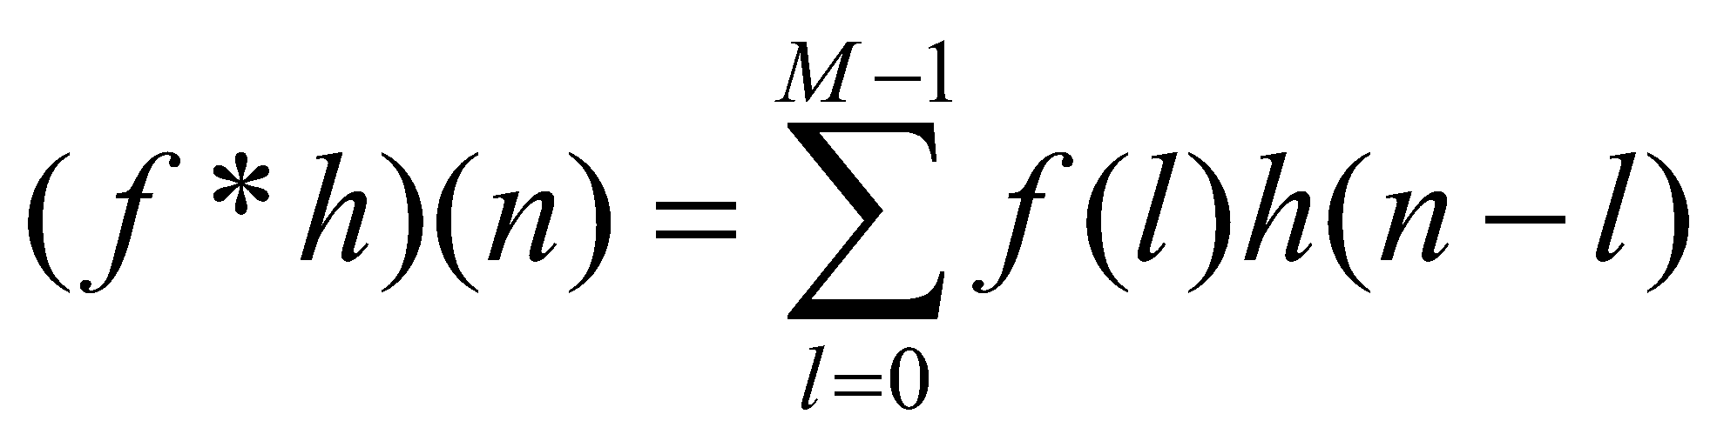
Convolution of discrete signals
Consider the discrete convolution:
To convolve f with h, you need to (1) flip h about the origin, (2) translate the flipped signal by an amount n, and (3) compute the sum in the above formula.
Steps 2 and 3 are repeated for each value of n.
The variable n ranges over all integers required to completely slide h over f.
If h and f have size M, then n has to range up to 2M-1.

Slide 18
Convolution of discrete signals
In other words, the resultant signal must have length of 2M-1.
The convolution can be implemented in the time/spatial domain – and MATLAB has a routine called conv which does the job for you!
Now imagine you tried to implement the convolution using a DFT of M-point signals followed by an M-point IDFT.
Owing to the assumed periodicity, you would get an undesirable wrap-around effect. See next slide for an illustration.

Slide 19
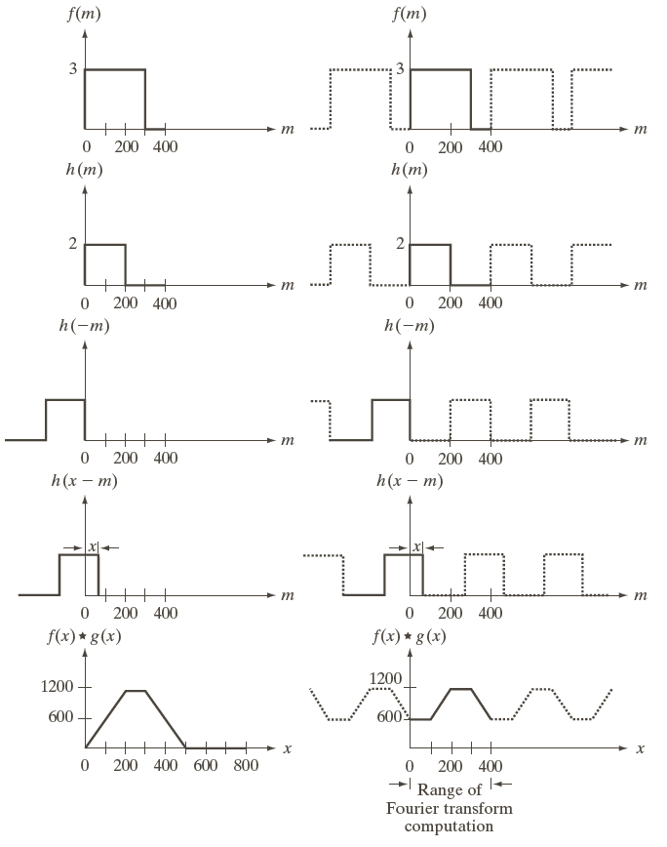
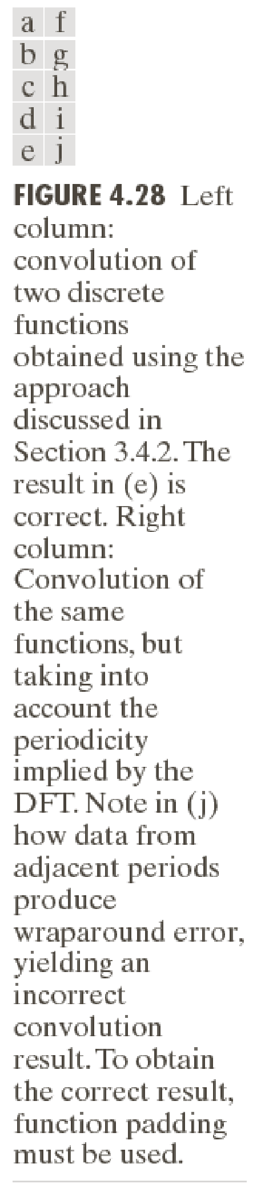

Slide 20
Convolution of discrete signals
How does one deal with this conundrum?
If f has length M and h has length K, then you should zero-pad both sequences so that they now have length at least M+K-1.
Then compute M+K-1 point DFT for both, multiply the DFTs and compute the M+K-1 point IDFT.

Slide 21
Convolution of discrete signals: 2 methods
Consider you want to convolve signal f having N elements with signal h having K elements.
You can use the conv routine in MATLAB – which by default produces a signal of N+K-1 elements for you. It takes care of zero-padding internally for you.
The other (equivalent) alternative is to:
Append f with K-1 zeros.
Append h with N-1 zeros.
Compute the N+K-1 point DFT of f and h (using fft).
Multiply the two DFTs point-wise.
Compute the IDFT of the result – this gives you a signal with N+K-1 elements.
In both cases, you may wish to extract the first N elements of the resultant signal (note that the trailing K-1 elements may not be zeros!).

Slide 22
Why convolution using Fourier transforms?
The time complexity of computing the convolution of a signal of length M with another of length M is O(M²).
With a DFT computed naively, it would remain O(M²) – the complexity of multiplying a M x M matrix with a M x 1 vector.

Slide 23
Why convolution using Fourier transforms?
But there’s a smarter way of doing the same which computes the DFT in O(M log M) time.
That is called the Fast Fourier Transform, discovered by Cooley and Tukey in 1965.
It is based on a divide and conquer algorithmic strategy.
The same strategy can be used to compute the IDFT in O(M log M) time.
Hence convolution can now be computed in O(M log M) time.

Slide 24
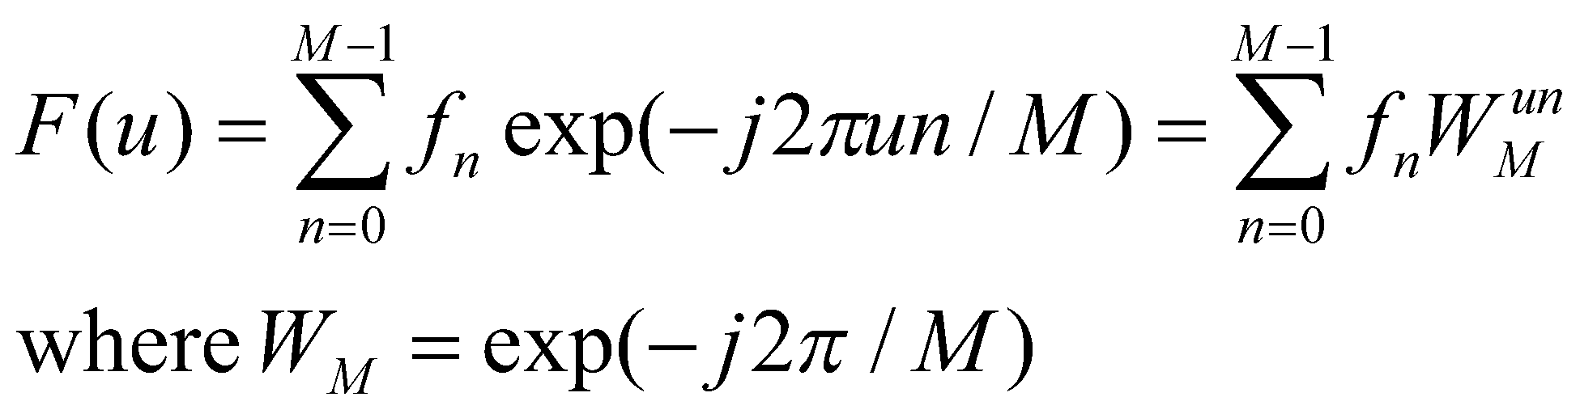
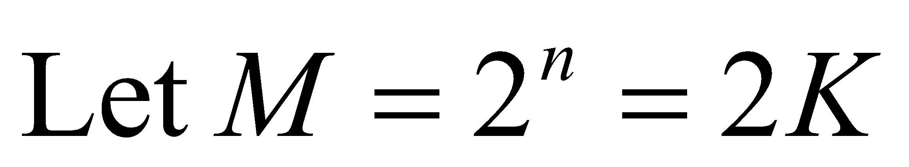
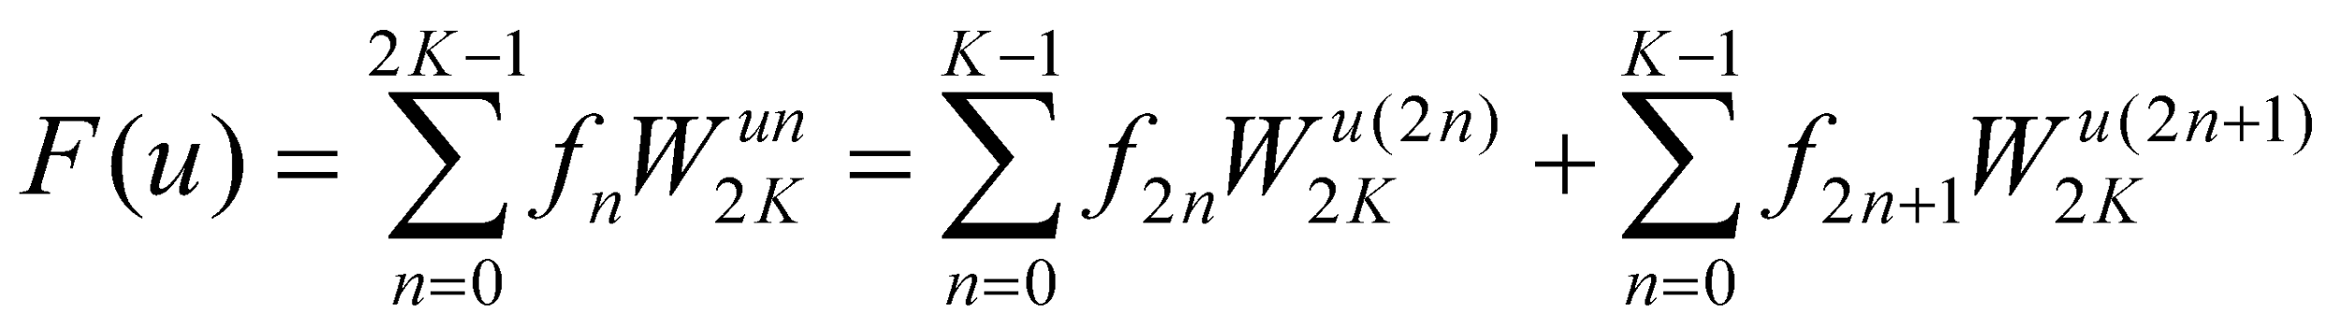
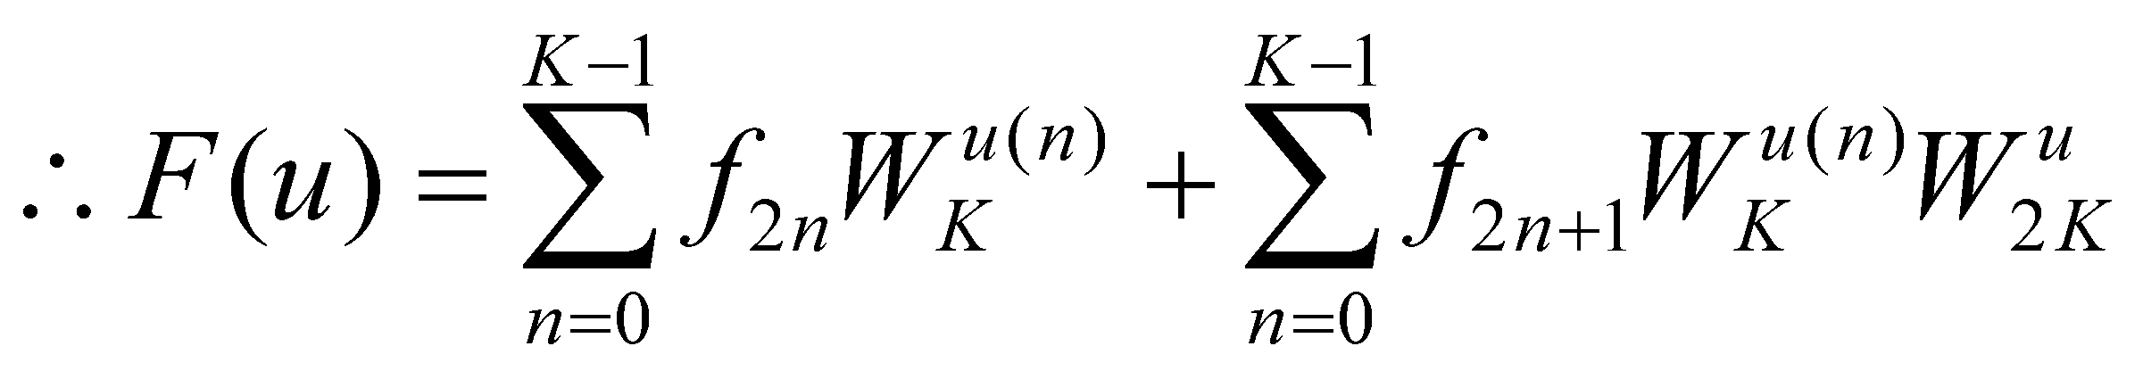
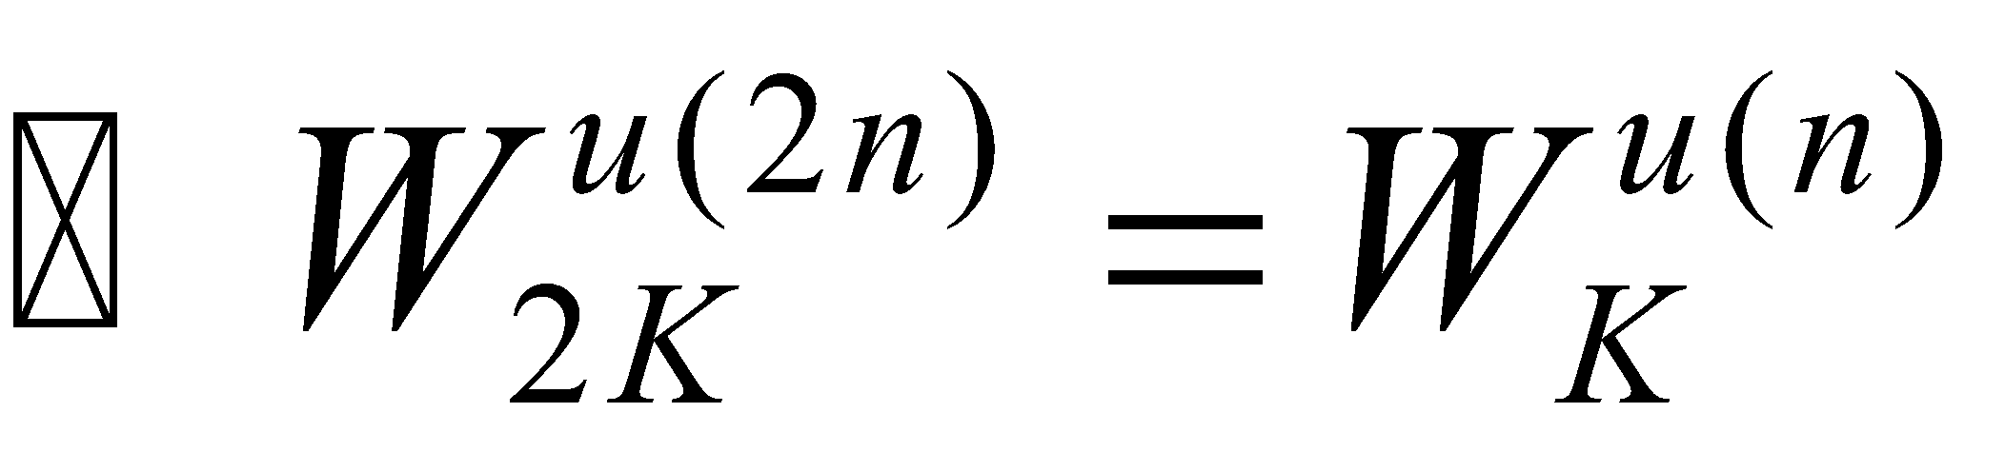
Towards the Fast Fourier Transform
Odd indices
Even indices

Slide 25
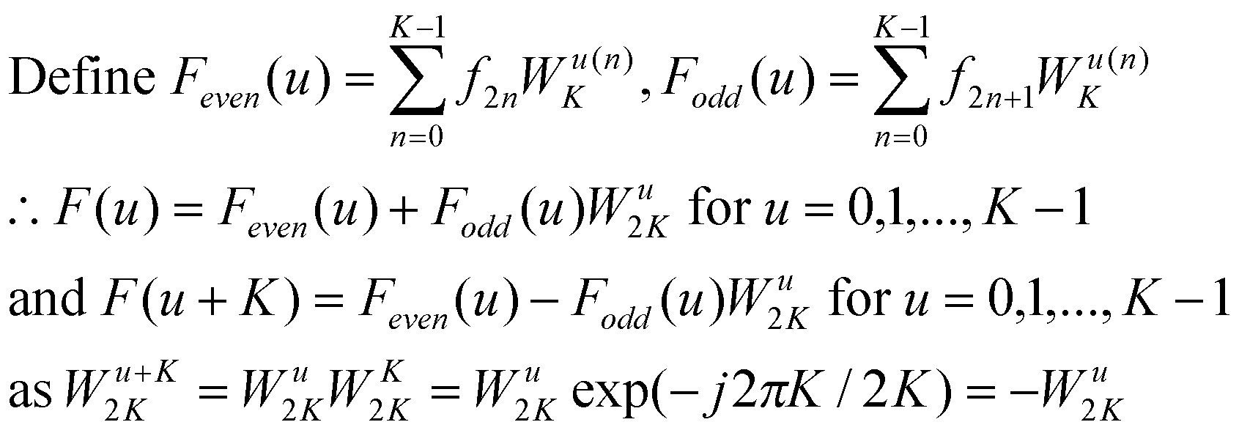
Towards the Fast Fourier Transform
The M-point DFT computation for F is split up into two halves. The first half requires two M/2-point DFT computations – one for F_{even}, one for F_{odd}. The second half follows directly without any additional transform evaluations once F_{even} and F_{odd} are computed. Now F_{even} and F_{odd} can be further split up recursively.

Slide 26
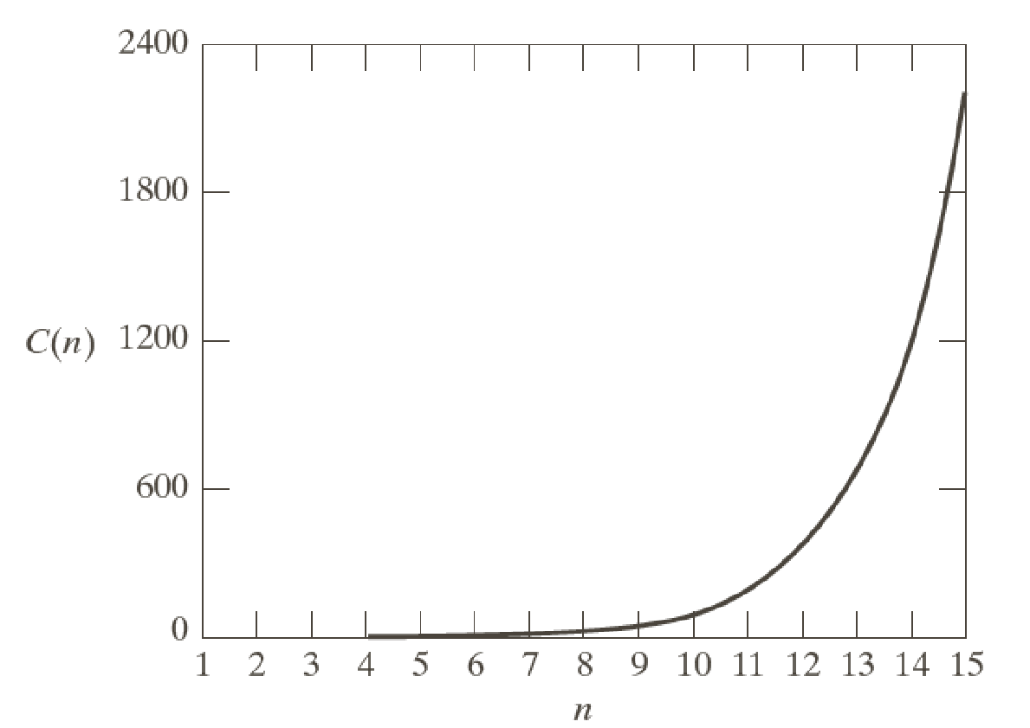
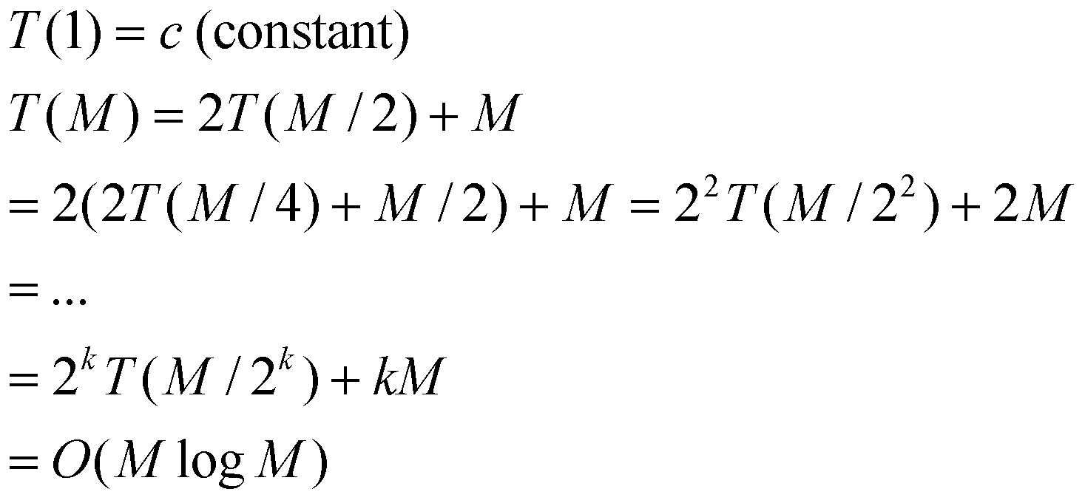
Towards the Fast Fourier Transform
The M-point DFT computation for F is split up into two halves. The first half requires two M/2-point DFT computations – one for F_{even}, one for F_{odd}. The second half follows directly without any additional transform evaluations once F_{even} and F_{odd} are computed. Now F_{even} and F_{odd} can be further split up recursively.
This gives:
T(M)
M
There is also a fast inverse Fourier transform which works quite similarly in O(M log M) time. The speedup achieved by the fast fourier transform over a naïve DFT computation is rather dramatic for large M!

Slide 27
MATLAB implementation
The Fast Fourier Transform is implemented in MATLAB directly – there are the routines fft and ifft for the inverse.

Slide 28
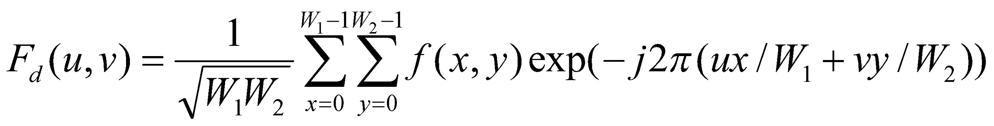
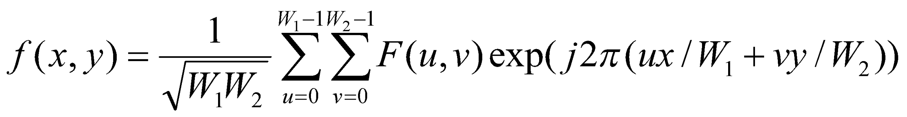
2D-DFT
Given a 2D discrete signal (image) f(x,y) of size W₁ by W₂, its DFT is given as:

Slide 29
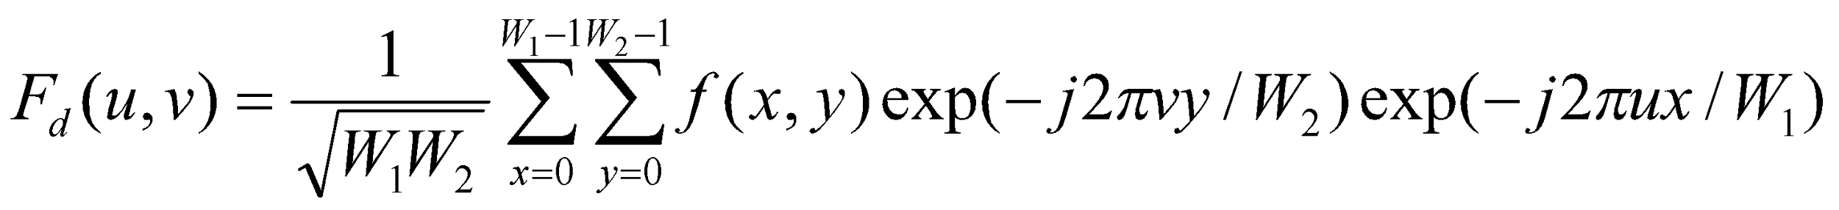
2D-DFT computation
Given a 2D discrete signal (image) f(x,y) of size W₁ by W₂, its DFT is given as:
Compute row-wise FFT, followed by a column-wise FFT. Overall complexity is W₁W₂ log(W₁W₂).

Slide 30
MATLAB implementation
The FFT for 2D arrays or images is implemented in MATLAB routines fft2 and ifft2.

Slide 31
2D-DFT properties
Linearity: F(af+bg)(u,v) = aF(f)(u,v) + bF(g)(u,v) where a and b are scalars.
Periodicity: F(u,v) = F(u + k₁W₁,v) = F(u,v + k₂W₂)= F(u + k₁W₁,v + k₂W₂) for integer k₁ and k₂.
And so is the inverse DFT since f(x,y) = f(x + k₁W₁,y) = f(x,y + k₂W₂)= f(x + k₁W₁,y + k₂W₂) for integer k₁ and k₂.

Slide 32
2D-DFT: Magnitude and phase
The phase carries very critical information.
If you retain the magnitude of the Fourier transform of an image, but change its phase, the appearance drastically changes.

Slide 33

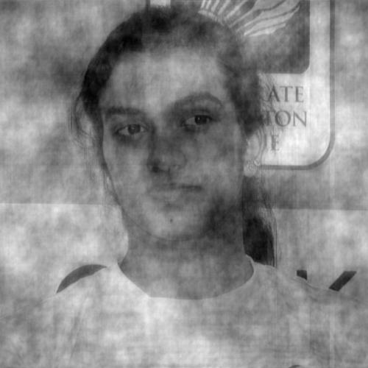
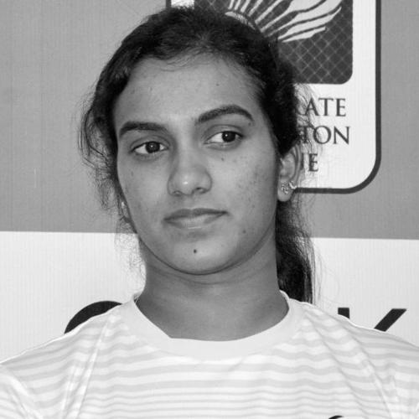
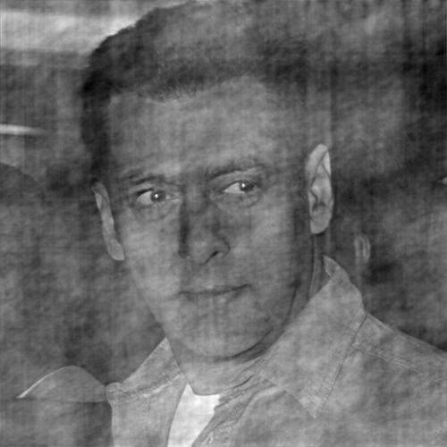
IFT (Magnitude of FT of Salman Khan times phase of P V Sindhu)
IFT (Magnitude of FT of P V Sindhu times phase of Salman Khan)

Slide 34
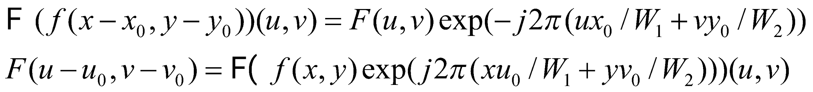
2D-DFT properties
Translation:
Note that translation of a signal does not change the magnitude of the Fourier transform – only its phase.

Slide 35
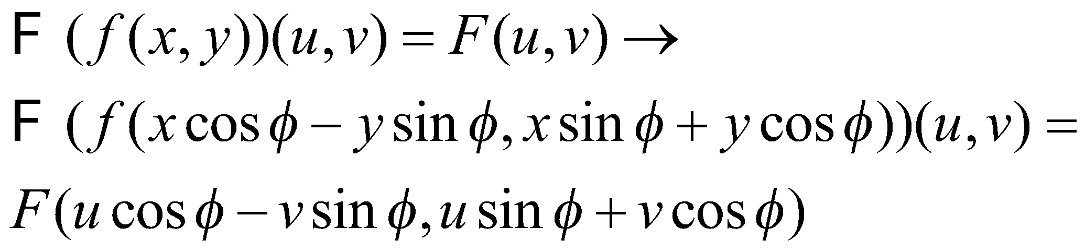
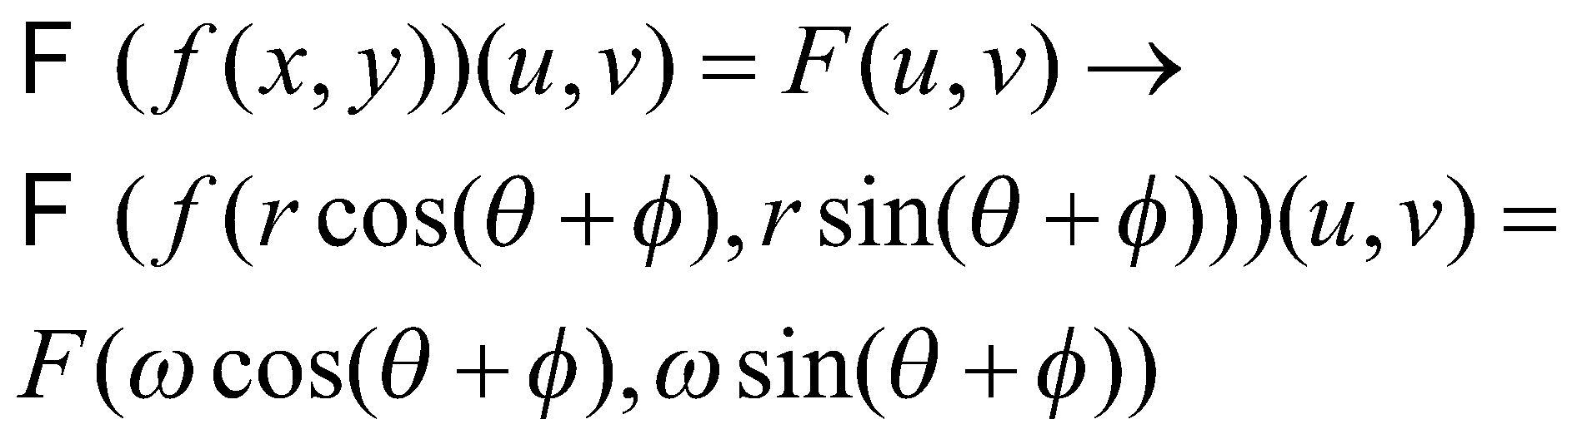
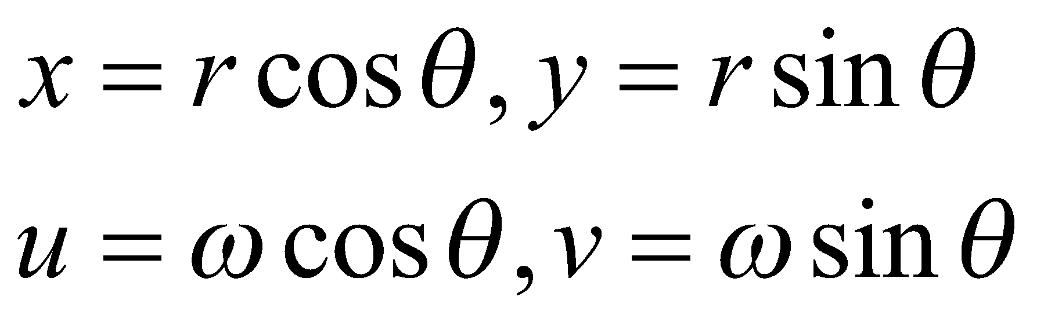
2D-DFT properties
The Fourier transform of a rotated image yields a rotated version of its Fourier transform
If you consider conversion to polar coordinates, then we have:

Slide 36
2D-DFT visualization in MATLAB
In the formula for the DFT, the frequency range from u = 0 to u = M-1 actually represents two half periods back to back meeting at M/2 (see next slide).
It is more convenient to instead view a complete period of the DFT instead.
For that purpose we visualize F(u-M/2) instead of F(u) in 1D, and F(u-W₁/2,v-W₂/2) instead of F(u,v) in 2D.
Thereby frequency u = 0 or u = v = 0 now occurs at the center of the displayed Fourier transform.
Note that F(u-W₁/2,v-W₂/2) = F(f(x,y)(-1)^{x+y})(u,v), so the centering operation is easy to implement.

Slide 37
One full period
Two half periods – back to back

Slide 38
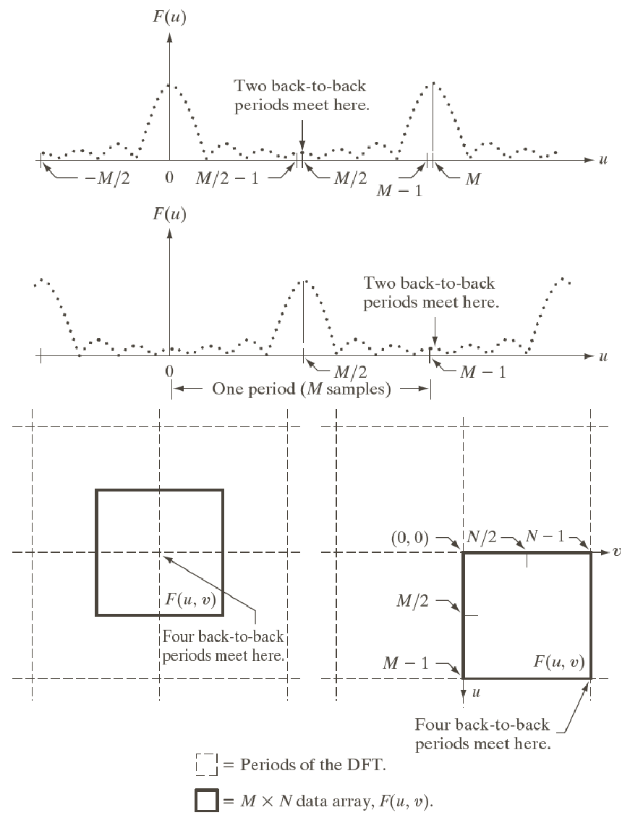
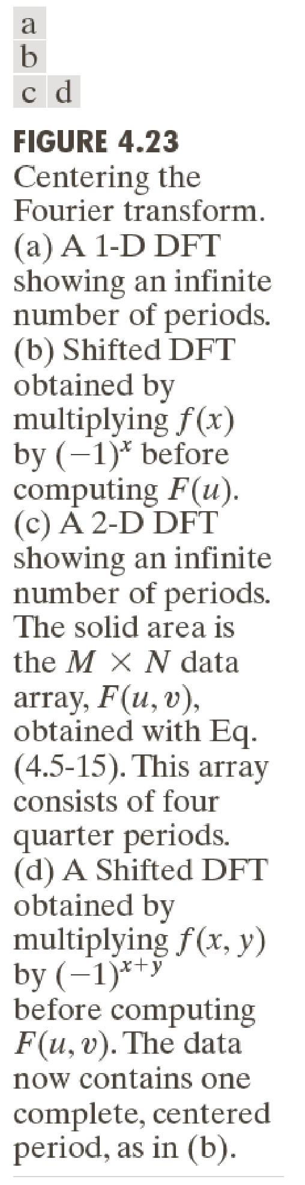

Slide 39
2D-DFT visualization in MATLAB
To visualize the DFT of an image, we visualize the magnitude of the DFT.
The Fourier transform is first centered as mentioned on the previous slide.
Due to the large range of magnitude values, the DFT magnitudes are visualized on a logarithmic scale, i.e. we view log(|F(u,v)|+1) where the 1 is added for stability.

Slide 40
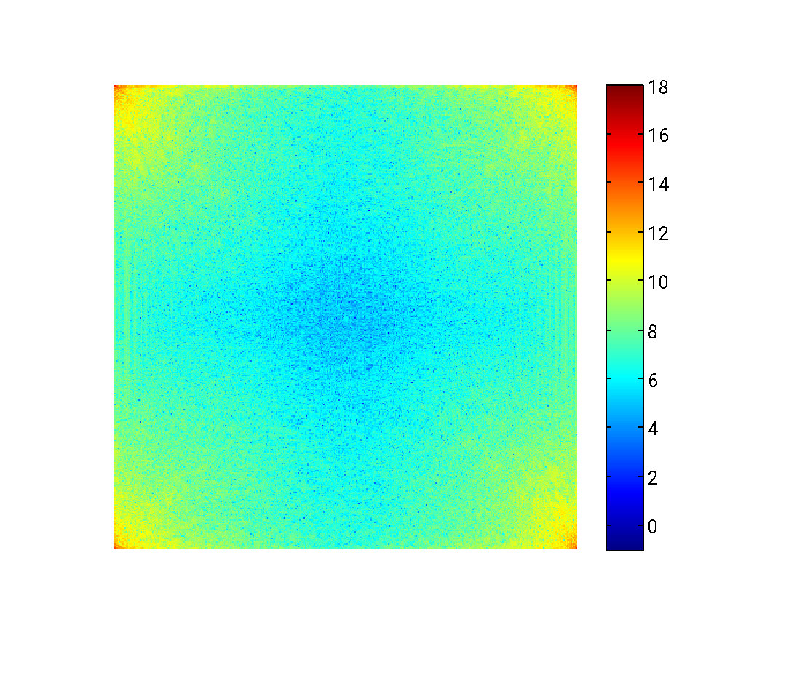
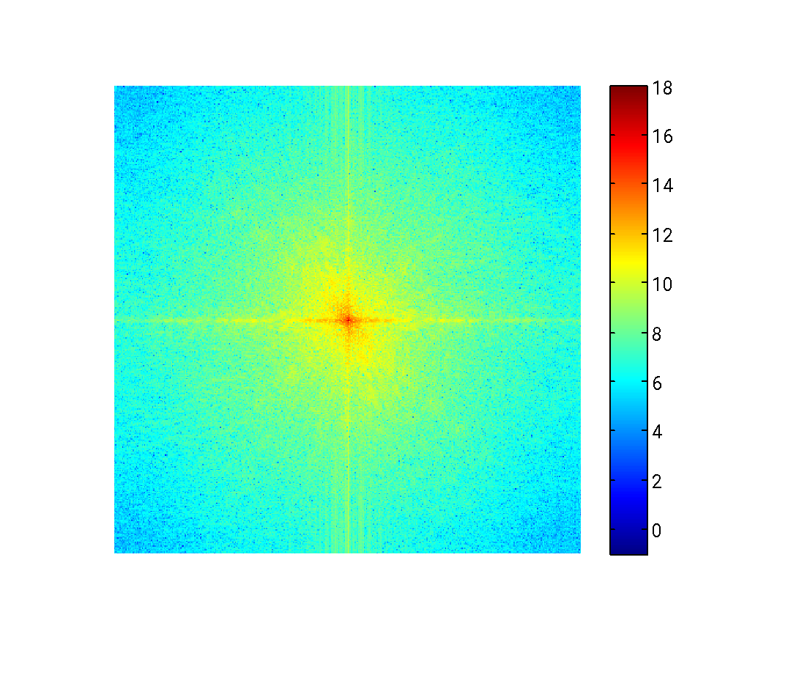
Without centering the fft
fim2 = fft2(im2);
absfim2 = log(abs(fim2)+1);
imshow(absfim1,[-1 18]);
colormap (jet); colorbar;
The (0,0) frequency lies at the
top left corner
v
u
With centering the fft
fim2 = fftshift(fft2(im2));
absfim2 = log(abs(fim2)+1);
imshow(absfim1,[-1 18]);
colormap (jet); colorbar;
The (0,0) frequency lies in the
Center.
v
u

Slide 41
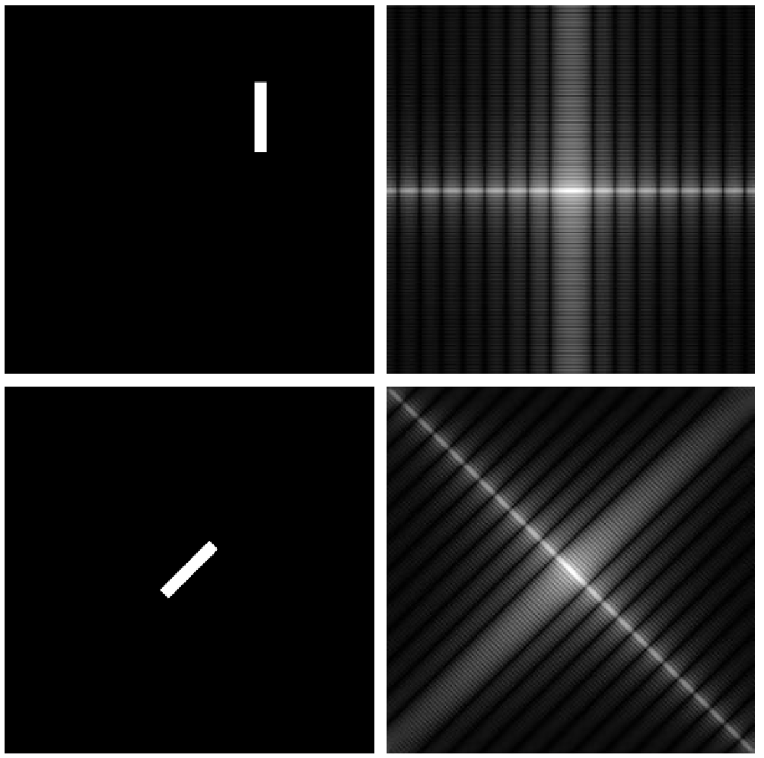
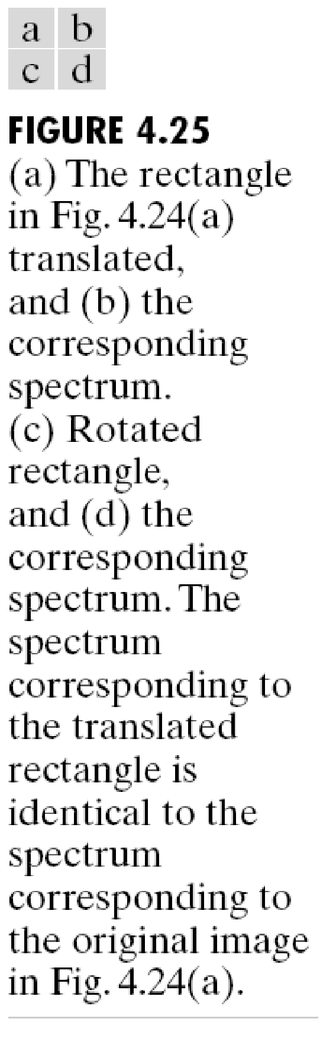
“Viewing” the rotation property of the DFT

Slide 42
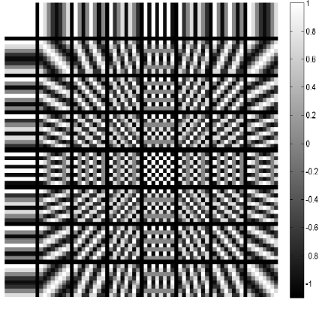
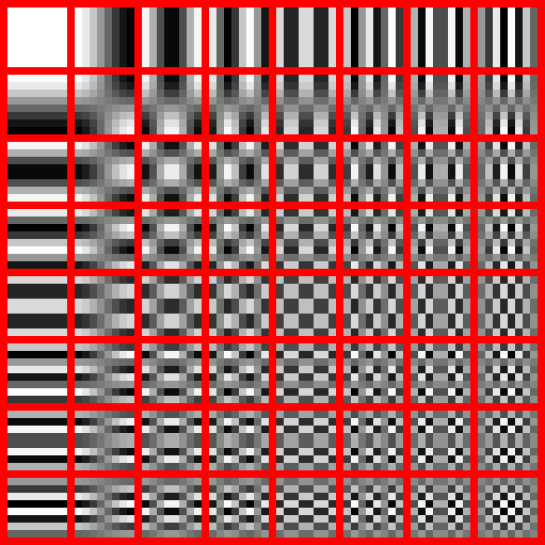
Visualizing DFT bases in 2D
Real part of DFT
Discrete cosine transform (for comparison only)
Each image represents a column of the 2D DFT matrix reshaped to form an image. Only the real component is displayed here. Our theory says that any discrete image can be accurately represented as a linear combination of such basis images. The coefficients of the linear combination may be positive, negative or zero, and real or complex in value. Note that pixel (x,y) of the image for frequency (u,v) represents: Exp(j 2*pi*(ux + vy)/N)
http://en.wikipedia.org/wiki/JPEG

Slide 43
2D convolution
In MATLAB, 2D convolution can be implemented using the routine conv2.
This can be very expensive if the signals you wish to convolve another with, are of large size.
Hence one resorts to the convolution theorem which holds in 2D as well.

Slide 44
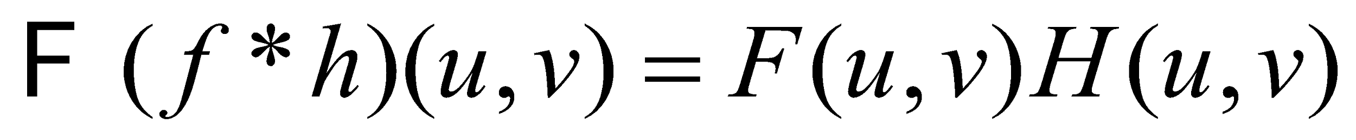
2D convolution
The convolution theorem applies to 2D-DFTs as well:
Consider an image f of size W₁ x W₂ which you want to convolve with a kernel k of size K₁ x K₂ using the DFT method.
Then you should symmetrically zero-pad f and k so that they acquire size (W₁+K₁-1) x (W₂+K₂-1).
Compute the DFTs of the zero-padded images using the FFT algorithm, point-wise multiply them and obtain the IDFT of the result.
Extract the central W₁ x W₂ portion of the result – for the final answer.

Slide 45
Image Filtering: Frequency domain
You have studied image filters of various types: mean filter, Gaussian filter, bilateral filter, patch-based filter.
The former two are linear filters and the latter two aren’t.
Linear filters are represented using convolutions and hence have a frequency domain interpretation as seen on the previous slides.

Slide 46
Image Filtering: Frequency domain
Hence such filters can also be designed in the frequency domain.
In certain applications, it is in fact more intuitive to design filters directly in the frequency domain.
Why? Because you get to design directly which frequency components to weaken/eliminate and which ones to boost, and by how much.

Slide 47
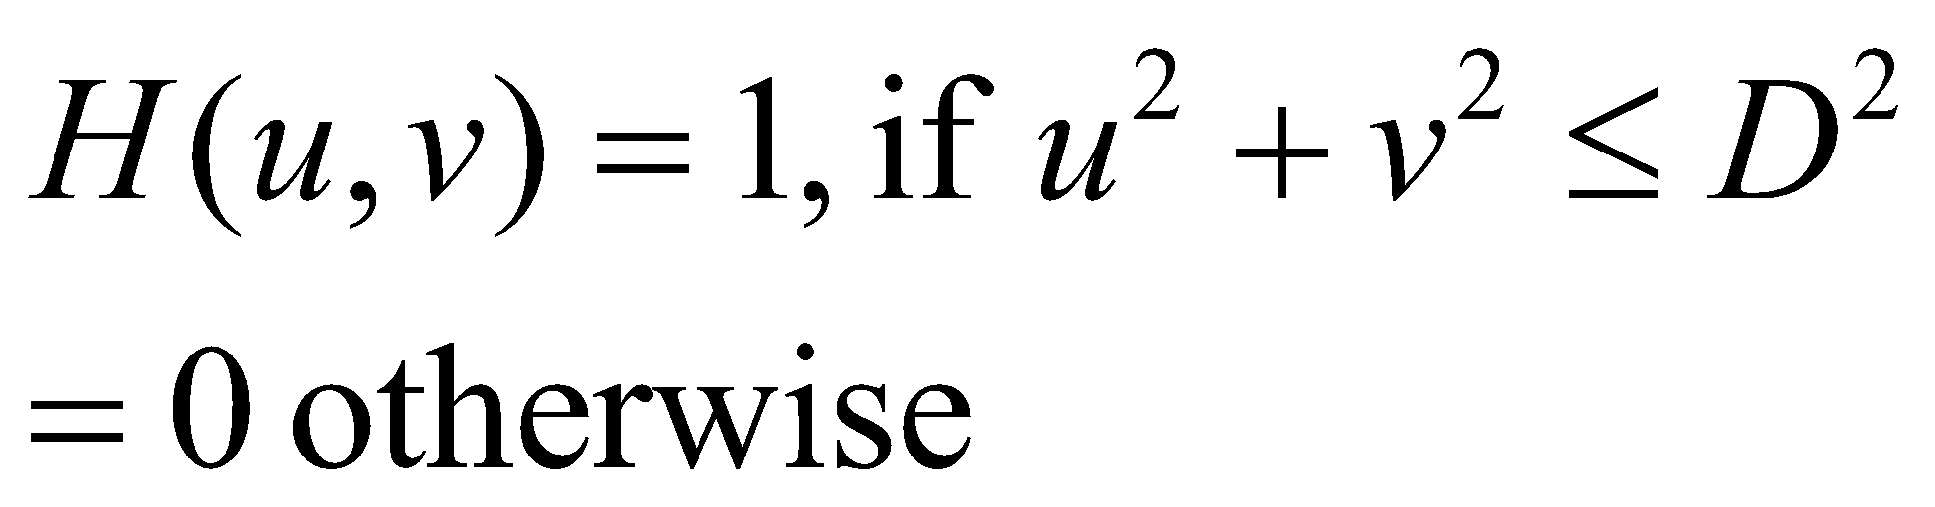
Low pass filters
Edges and fine textures in images contribute significantly to the high frequency content of an image.
When you smooth/blur an image, these edges and textures are weakened (or removed).
Such filters allow only the low frequencies to remain intact and are called as low pass filters.
In the frequency domain, an ideal low pass filter can be represented as follows:
Note: we are assuming (0,0) to be the center (lowest) frequency. Frequencies outside a radius of D from the center frequency are eliminated.

Slide 48
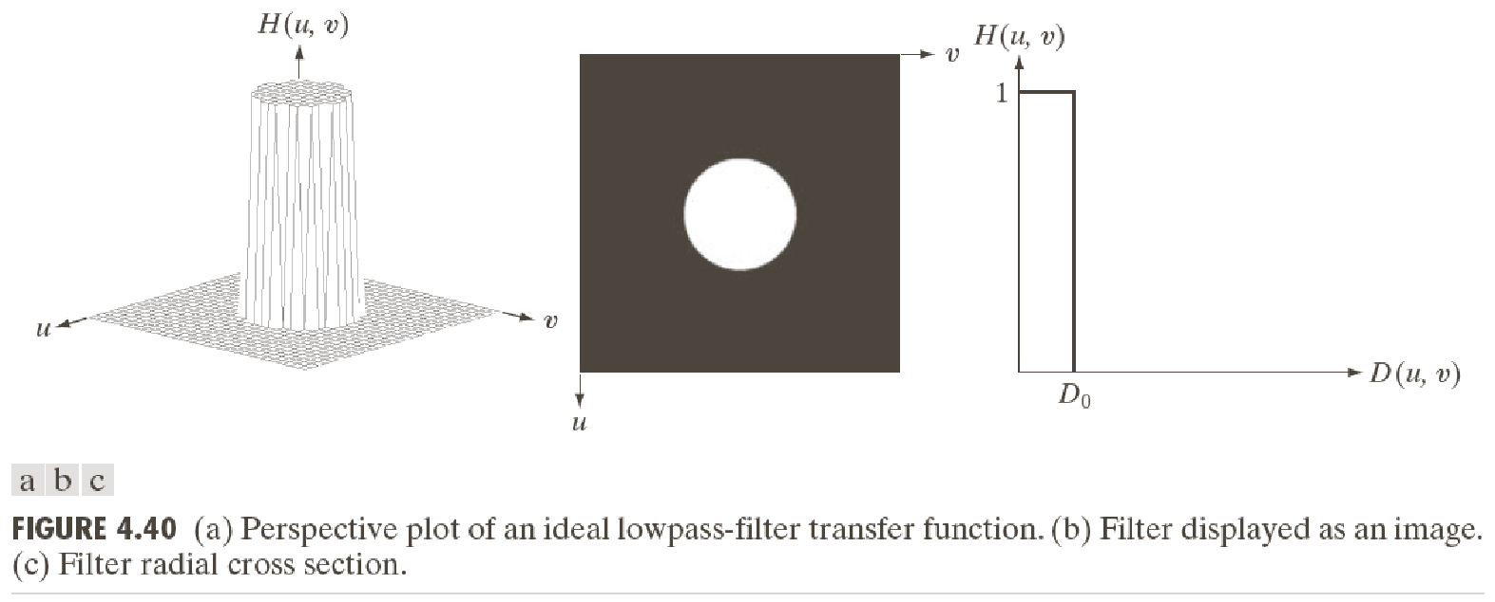
Low pass filters

Slide 49
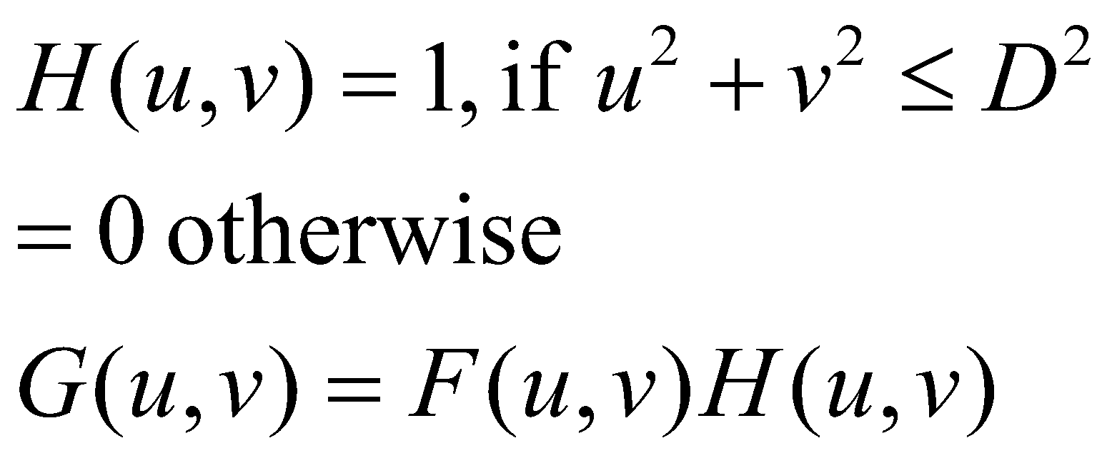
Low pass filters
To apply such a filter to an image f to create a filtered image g, we do as follows:
D is a design parameter of the filter – often called the cutoff frequency.
This is called the ideal low pass filter as it completely eliminates frequencies outside the chosen radius.

Slide 50


Low pass filters
Notice the ringing artifacts around the edges!

Slide 51

Low pass filters
The ringing artifacts can be explained by the convolution theorem.
The corresponding spatial domain filter is called the jinc function.
The jinc is a 2D and circularly symmetric version of the sinc function – see also the next slide.
Any cross section of the jinc is basically a sinc function.
https://en.wikipedia.org/wiki/Sombrero_function

Slide 52


An image can be regarded as a weighted sum of Kronecker delta functions (impulses). Convolving with a sinc function means placing copies of the sinc function at each impulse. The central lobe of the sinc function causes the blurring and the smaller lobes give rise to the “ripple artifacts” or ringing.

Slide 53

Low pass filters: other types
These ringing artifacts can be quite undesirable.
Hence the ideal low pass filter is replaced by other types of low pass filters which weaken but do not totally eliminate the higher frequencies.
For example:
Butterworth filter:
D = cutoff frequency, n = order of the filter
Gaussian filter

Slide 54




Slide 55
Low pass filters: Butterworth
As D increases, the Butterworth filter allows more frequencies to pass through without weakening (see previous slide).
As the order n increases, the Butterworth filter weakens the higher frequencies more aggressively (why?) – which actually increases ringing artifacts (see previous slide).

Slide 56




Slide 57

Low pass filters: Gaussian
The spatial domain representation for the Gaussian LPF is basically a Gaussian.
In fact, the following are Fourier transform pairs:
http://www.cse.yorku.ca/~kosta/CompVis_Notes/fourier_transform_Gaussian.pdf
Notice from the equations that a spatial domain Gaussian with high standard deviation corresponds to a frequency domain Gaussian with low cut off frequency! The extreme case of this is a constant intensity signal (Gaussian with very high standard deviation – infinite as such) whose Fourier transform is an impulse at the origin of the Frequency plane). Another extreme case is a spatial domain signal which is just an impulse – its Fourier transform has constant amplitude everywhere.

Slide 58


High pass filter
It is a filter that allows high frequencies and eliminates or weakens the lower frequencies.
The equation for the frequency response of an ideal high pass filter is given as:
In fact, given an LPF, an HPF can be constructed from it using:

Slide 59



Slide 60


Slide 61


Ringing artifacts for an Ideal HPF!
Ringing artifacts gone!

Slide 62

Ringing artifacts for an Ideal HPF!
Ringing artifacts gone!

Slide 63


High pass filters
Note that any gradient-based operation on images is essentially a type of high-pass filter.
This includes first order derivative filters or the Laplacian filter.
Why? Consider the first order derivative filter in y direction.

Slide 64


High pass filters
Consider the Laplacian filter:

Slide 65
Boosting high frequencies
In some applications, you neither wish to weaken the higher frequencies nor the lower frequencies.
For example, in image sharpening applications you wish to boost the edges or textures (basically higher frequencies).
In that case you wish to perform operations of the following form:

Slide 66




Slide 67
Notch filters
There are applications where images are presented with periodic noise patterns – e.g. images scanned from old newspapers (see next slide).
Usually, the amplitudes of the Fourier components of natural images are seen to decay with frequency.
The Fourier transform of images with periodic patterns show unnatural peaks – unlike ordinary natural images.
Such images can be restored using notch filters, which basically weaken or eliminate these unnatural frequency components (or any frequency components specified by the user).

Slide 68


The yellow ellipses indicate unnatural peaks in the Fourier transform of the image with the superimposed interfering pattern. These are unnatural because typical images do not have such Fourier transforms. Therefore one can apply a notch filter to remove the interfering pattern.

Slide 69



Slide 70

Courtesy: http://www.robots.ox.ac.uk/~az/lectures/ia/lect2.pdf

Slide 71

Courtesy: http://www.robots.ox.ac.uk/~az/lectures/ia/lect2.pdf

Slide 72


Notch filters
The expression for a notch filter frequency response is given as follows (Q = number of frequency components to suppress):
Ideal notch reject filter
Gaussian notch reject filter

Slide 73
Algorithm for frequency domain filtering
Consider you have to filter an image f of size H x W using one of the filters described in these slides.
Zero pad the image symmetrically to create a new image f’ of size 2H x 2W.
Compute the Fourier transform of f’ and center it using fftshift. Let the Fourier transform be F’(u,v).
Design a frequency domain filter H(u,v) of size 2H x 2W with the zero frequency at index (H,W) of the 2D filter array.
Compute the product F’(u,v)H(u,v).
Compute the inverse Fourier transform of the product after applying ifftshift (to undo the effect of fftshift).
Consider only the real part of the inverse Fourier transform and extract the central portion of size H x W.
That gives you the final filtered image.
Note that the zero padding is important. To understand the difference, see the results on the next slide with and without zero-padding.

Slide 74



Original image
Effect of Gaussian LPF with appropriate zero padding
Effect of Gaussian LPF without appropriate zero padding – zero the border artifacts!

Slide 75
Interpreting the DFT of Natural Images
In a few cases, one can guess some structural properties of an image by looking at its Fourier transform.
Most natural images have stronger low frequency components as compared to higher frequency components. This is generally true, although its not a strictly monotonic relationship.
For example, how does the DFT of a vertical edge image look like?

Slide 76


There is a sinc function along the u axis!

Slide 77



Strong horizontal and vertical edges = strong responses along u and v axes in the Fourier plane!
A strong edge in direction θ in XY plane = a strong response in the direction perpendicular to θ in UV plane

Slide 78
Interpreting the DFT
For an image (or any 2D array) with Fourier transform F(u,v), F(0,0) is proportional to the average value of the image intensity – why?
The DFT of a non-zero constant intensity image is basically an impulse at the zero frequency. What is the height of the impulse?

Slide 79
DFT limitations
A strong response at frequency (u,v) (i.e. a large magnitude for F(u,v)) indicates the presence of a sinusoid with frequency (u,v) and with large amplitude somewhere in the image.
In general, the Fourier transform cannot and does not tell us where in the image the sinusoid is located (read section 1 of http://users.rowan.edu/~polikar/WAVELETS/WTpart1.html ).
For that, you need to compute separate Fourier transforms over smaller regions of the image (Short time Fourier transform) – that will tell you which region(s) contained a particular sinusoidal component.

Slide 80
Fun with Fourier: Hybrid images
Hybrid images are a superposition of an image J₁ with strong low frequency components and weak higher frequency components, and an image J₂ with stronger higher frequency components and weak lower frequency components.
J₁ = apply LPF with some cutoff frequency D on an image.
J₂ = apply HPF with some cutoff frequency D on another image.
The appearance of the hybrid image changes with viewing distance!

Slide 81


Tiger – when seen up-close, Cheetah – when seen from far
Einstein from nearby,
Marilyn Monroe from far away (or if you squint)!
Refer to:
http://cvcl.mit.edu/hybrid_gallery/monroe_einstein.html
http://cvcl.mit.edu/publications/OlivaTorralb_Hybrid_Siggraph06.pdf (paper from a graphics journal!)

Slide 82
Fourier in action: tomographic reconstruction
Tomography refers to the process of estimation of the internal structure of an object (tomos in Greek means interior).
This is different from photographic imaging which images only the object surface.
Tomography is typically accomplished via X Rays and the so called Radon transform.

Slide 83

Radon transform
Imagine a line was drawn through the 2D image in a certain direction α, and you integrated the intensity values along that line.
Now you repeat this for lines parallel to the original one but at different offsets.
Each such summation produces a “bin” of the “tomographic projection”.
The collection of bins form a 1D array which is called the tomographic projection or the Radon transform of the object in the direction α.

Slide 84
Reconstruction from the Radon Transform
The Radon transform computation can be similarly repeated for multiple angles.
The aim of tomographic reconstruction is to reconstruct the 2D image from a collection of its 1D tomographic projections in different angles.

Slide 85




Fourier transform of the Radon Transform
The Radon transform is given as:
Its 1D Fourier transform w.r.t. ρ (keeping ϴ fixed to some value) is given by:
G(μ, ϴ) is the Fourier transform of the projection of f(x,y) along some direction ϴ.

Slide 86

Fourier transform of the Radon Transform
Its 1D Fourier transform w.r.t. ρ (keeping ϴ fixed) is given by:
The RHS of this equation is a slice of the 2D Fourier transform of f(x,y), i.e. F(u,v), along the angle ϴ in the frequency plane, and passing through the origin
This equation above is called the Projection Slice Theorem or the Fourier Slice Theorem. It states that the Fourier transform of a projection of the 2D object along some direction ϴ (i.e. G(μ, ϴ)) is equal to a slice of the 2D Fourier transform of the object along the same direction ϴ (in the frequency plane), passing through the origin.

Slide 87
Reconstruction from the Radon transfer
The projection slice theorem thus tells you that you can fill up the 2D Fourier transform of the original image – since the 1D Fourier transform of the projection at angle θ is equal to a slice of the 2D Fourier transform of the image at the angle θ through the origin of the (u,v) plane.
Thus given different projections, each at different angles, you can fill up the Fourier transform of the original image. The final inverse Fourier transform gives you a reconstruction of the image.

Slide 88

How does the Radon transform show up in tomographic acquisition?
Let I₀ be the intensity of the X-ray beam sent through the object f at angle θ.
The materials in the object absorb the X-rays partially.
The remaining energy is sent out and is measured by a detector.
As per Beer’s law, the energy measured at the detector is given by:
Measured projection vector (many bins) at angle θ
Radon transform of object f at angle θ

Slide 89
Fourier transforms in actual acquisition
Computed tomography (in an indirect way via the Fourier slice theorem)
Magnetic resonance imaging – the machine measures the Fourier transform of the object placed inside!
Optics: in diffraction, only the squared magnitudes of the Fourier transform are measured – phase retrieval problem.

Slide 90
Applications of the Fourier transform in image processing
Filtering: efficient implementation of the convolution
Filtering: frequency domain filters
Others: solving partial differential equations (not covered).

Slide 91


Appendix: Fourier transform of an impulse train
Impulse train is given by:
It is a periodic signal with period ∆T, and hence it can be expressed by a Fourier series:

Slide 92


Appendix: Fourier transform of an impulse train
Simplifying the Fourier series coefficients, we have:
Thus the Fourier transform of an impulse train with period ∆T is also an impulse train with period 1/∆T. (Compare: The Fourier transform of a Gaussian is also a Gaussian with an inverted standard deviation). There are a few other functions that are their own Fourier transform.

Slide 93
Appendix: Sampling Theorem
This is a very important theorem in signal processing.
Different parts of it were independently discovered by Shannon, Nyquist, Whittaker and Kotelnikov.
It is often called Shannon’s sampling theorem or the Shannon-Nyquist sampling theorem, but it may well be called the Shannon-Nyquist-Whittaker-Kotelnikov sampling theorem.

Slide 94
Appendix: Sampling Theorem
The theorem states that any band-limited signal with maximum frequency B can be accurately reconstructed from its equi-spaced time-domain samples provided the sampling rate is more than 2B (equivalently the sampling period is less than 1/2B).
The reconstruction of the original (analog) signal from its time-domain samples proceeds by sinc interpolation – we will see it later.
An intuitive proof of the sampling theorem can be seen from the next four slides (pictorially).

Slide 95


Appendix: Sampling Theorem
f(t) is an underlying analog signal which is bandlimited, and whose equi-spaced time-domain samples we observe (second figure). The aim is to recover f(t) accurately from its sampled version. The gap between the samples is ∆T.

Slide 96
Appendix: Sampling Theorem
F(µ) is the Fourier transform of f(t) (observe the bandlimitedness). In the second row, we see the Fourier transform of its sampled version – we have earlier proved that it would be equal to the summation of infinitely many copies of F(µ). If ∆T is too large, then the different periods will merge and cause aliasing. Hence ∆T has to be “small enough”.

Slide 97


Appendix: Sampling Theorem
F(µ) is the Fourier transform of f(t) (observe the bandlimitedness). In the second row, we see the Fourier transform of its sampled version – we have earlier proved that it would be equal to the summation of infinitely many copies of F(µ). If ∆T is too large, then the different periods will merge and cause aliasing. Hence ∆T has to be “small enough”. As seen in sub-figure b here, we must have 1/ ∆T > 2µ_{max} .

Slide 98


Appendix: Sampling Theorem

Slide 99

Appendix: Sampling Theorem
Refer to the previous slide. We have:
This is called the Whittaker-Shannon interpolation formula. In practice, it requires infinite summation, and hence methods like bilinear or bicubic interpolation are preferred. It can be implemented in truncated form, with some error
The inverse fourier transform of a rect is a sinc
Sampled version of f

Slide 100
Appendix: Sampling theorem in 2D
A 2D signal is band-limited if its Fourier transform is 0 outside a rectangle established by intervals [-µ_{max},+µ_{max}] and [-ν_{max},+ν_{max}].
The theorem states that such a continuous band-limited 2D signal can be accurately reconstructed from its equi-spaced spatial-domain samples provided the sampling rate is more than 2µ_{max} in the X-direction and more than 2ν_{max} in the Y-direction (equivalently the sampling period is less than 1/2µ_{max} and 1/2 ν_{max}).

Slide 101





Slide 102
Appendix: Sampling Theorem and Aliasing
If a signal is sampled at a rate less than the sampling rate, its analog version cannot be accurately reconstructed.
We get an erroneous version of that signal from its samples.
This phenomenon is called aliasing, because the (genuinely) higher frequency components “masquerade as” (i.e. pretend to be) lower frequency components.
Aliasing is illustrated in figure 4.6 of the book (also on slide 96 here).
A certain amount of aliasing is inevitable in practical signal or image acquisition, as in practice the signals can only be of finite length. And we know that time-limited or space-limited signals cannot be bandlimited.

Slide 103

Appendix: Sampling Theorem and Aliasing in 1D
Analog signal (to be reconstructed from its samples) shown in solid line:
f(t) = sin (πt),
Time period = 2 second
As per the sampling theorem, we need to sample this signal at a rate strictly greater than twice the largest frequency, i.e. greater than 2 x ½ = 1 sample per second. Equivalently the sampling rate must be strictly less than 1/(2 x ½) = 1 second. If you sample at exactly twice the largest frequency, i.e. 1 sample per second, you will collect values of sin (πt) for integer t, i.e. all zeroes. This will not allow for good reconstruction.

Slide 104

Appendix: Sampling Theorem and Aliasing in 2D (example 1)
Consider a perfect imaging system that can faithfully capture images of size 96 x 96 pixels (one pixel is the resolution or sampling period of the system in both X and Y directions). Such a system can faithfully capture a checkerboard pattern in which each square has size 1 pixel or more. See top row where the square width is 16 and 6 pixels respectively. But there is a problem if the size of the squares is less than 1 pixel: see bottom row where the squares have width 0.9174 and 0.4798 respectively. These produce misleading patterns which can masquerade as normal images.

Slide 105


Appendix: Sampling Theorem and Aliasing in 2D (example 2)
“original” shirt texture
Aliased shirt texture (see appearance of slanting patterns from top right to bottom keft near the midde shirt button)

Slide 106

Appendix: Sampling Theorem and Aliasing in 2D (example 3)
Aliasing can be controlled by a small amount of blurring – this is of course not without loss of information, but at least it does not produce fake textures.

Slide 107

Appendix: Sampling Theorem and Aliasing in 2D (example 4)
Jagged edges due to aliasing

